Slide 1
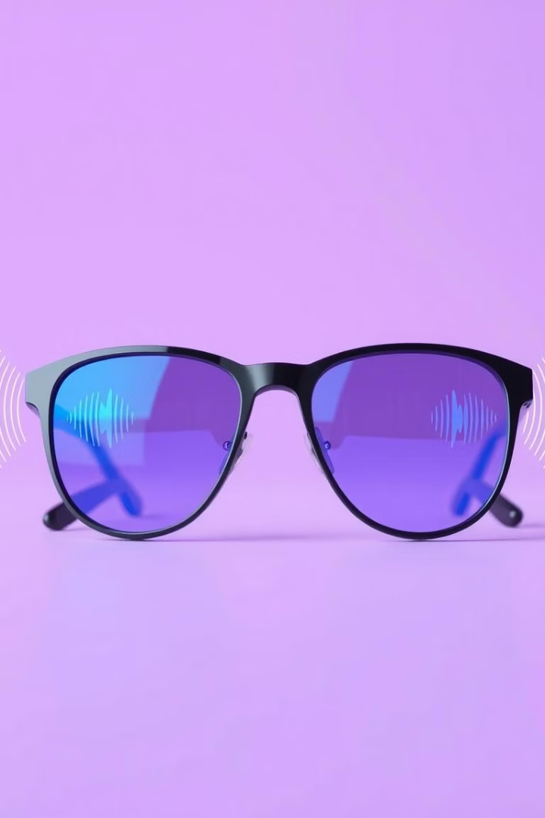
Revolutionising Accessibility: Aankh AI Smart Lens
Aankh empowers the deaf and hard-of-hearing community with AI-powered smart lens, transforming their lives with enhanced accessibility and a greater sense of independence. This presentation outlines Aankh's innovative features, real-world applications, and potential impact.

Slide 2

Breaking Barriers in Accessibility
466 million people worldwide experience disabling hearing loss, facing challenges in safety, communication, and social inclusion.
Current assistive technologies often fail to meet the needs of real-time interaction and situational awareness, leaving individuals feeling isolated and limited.

Slide 3
Introducing Aankh: AI-Powered Smart Lens
Real-time Transcription
Proximity alert
Voice Cues
Personalized Profiles
Translation and display of spoken vocabulary on Heads Up Display(HUD).
Camera and lidar in combination provide real time proximity object detection.
Support for multi mic array for voice input.
Allows users to create custom profiles to optimize sound settings for individual needs and preferences.
Important voice cues (honk,vehicles) are displayed on HUD.

Slide 4
Features provided for accessibility
1
Subtitles for Real-Time Speech-to-Text
Vibrational Feedback for Sounds
Augmented Reality for Sound Visualization
2
3
Effortlessly follow conversations with live subtitles, enhancing communication in various settings.
Stay informed about important sounds, ensuring safety and awareness in busy environments, and in cases of an notification.
Gain a greater understanding of sound direction and volume, enhancing situational awareness.
Real-Time Translation in Multiple Languages
5
AI-Enhanced Sound Recognition
4
Break down language barriers with instant translations, facilitating communication across cultures.
Aankh identifies specific sounds like alarms or vehicles, providing alerts tailored to user needs.

Slide 5


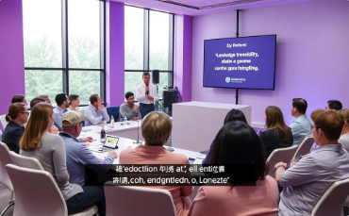

Use Cases of Aankh
Urban Navigation for Safety
Educational Support in Classrooms
Multilingual Business Interaction
Emergency Alerts in Public Spaces
Navigate busy city streets confidently with real-time alerts and visual cues, enhancing safety and independence.
Enjoy a more inclusive and engaging learning experience with real-time captions and visual aids.
Facilitate global communication with real-time translations, expanding professional opportunities.
Stay informed and safe during emergencies with clear alerts and visual guidance, ensuring timely action.

Slide 6




Advanced AI Behind Aankh
Context-aware Sound Filtering
1
Aankh intelligently filters out irrelevant background noise, focusing on important sounds.
Multilingual Transcription and Translation
2
Aankh accurately transcribes speech and translates it into multiple languages, breaking down language barriers.
Haptic Feedback Calibration
3
Aankh fine-tunes vibrations for different sound frequencies, providing a precise and tailored experience.
Augmented Reality Display
4
Aankh seamlessly integrates augmented reality overlays for sound visualization and navigation.

Slide 7

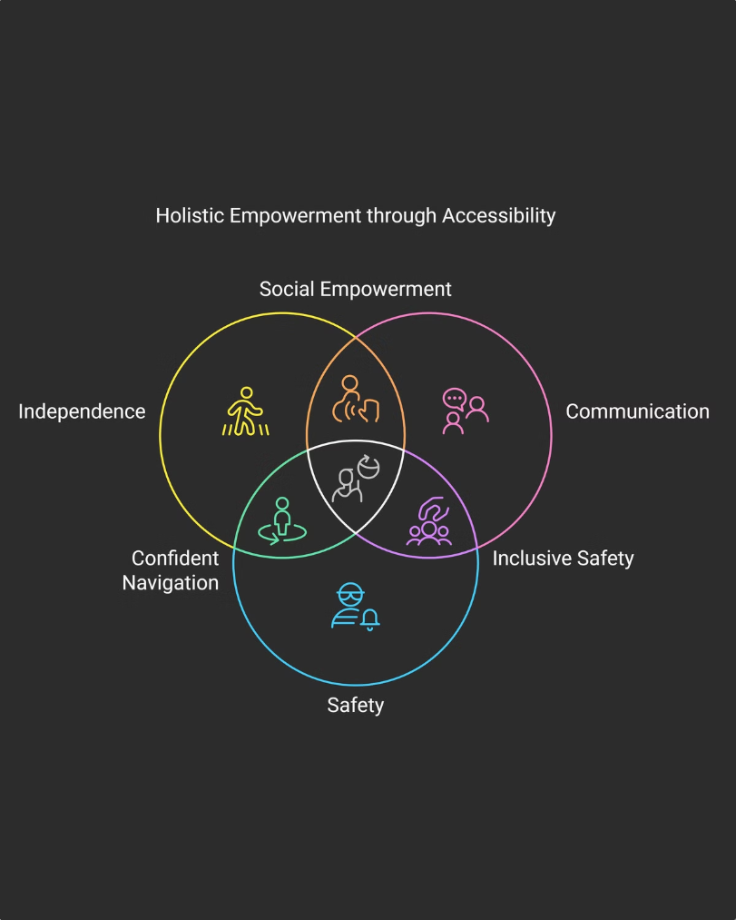



Empowering Lives Through Accessibility
Independence
Communication
Aankh promotes self-reliance and confidence, allowing individuals to navigate public spaces with greater ease.
Aankh enhances communication in social and professional settings, fostering inclusion and understanding.
Safety
Aankh improves safety through situational awareness, enabling individuals to react to potential hazards.

Slide 8
Overcoming Hurdles and Expanding Horizons
1
Privacy
Aankh prioritizes privacy and data security, employing secure encryption and user control over data access.
2
Battery Life
Aankh utilizes efficient energy management and offers extended battery life to meet user needs throughout the day.
3
Lightweight Design
Aankh design is lightweight and comfortable, ensuring prolonged wearability and a seamless user experience.
4
Sign Language Recognition
Future iterations of Aankh will include sign language recognition, further expanding accessibility and inclusivity.
5
Emotion and Social Context Detection
Aankh will evolve to detect emotions and social cues, creating a more nuanced and immersive communication experience.
6
Integration with Smart Home Devices
Aankh will seamlessly integrate with smart home devices, providing a comprehensive ecosystem for accessibility.

Slide 9

Aankh: A Catalyst for Change
Aankh revolutionizes accessibility, empowering inclusivity.
It blends innovation, compassion, and user-centric design.
Aankh promotes independence, confidence, and safety.
It fosters genuine inclusion and empowers full participation in life.
Positive impacts extend to a more understanding and empathetic society.

Slide 10
Future Scope of the project
Enhancing the AI model by training the LLM.
Integrating sign language recognition to convert gestures into speech or text, improving accessibility.
Adding a social interaction mode for emotion and facial expression recognition.
Functioning as a smart assistant by integrating with Siri and Google Assistant.
Developing lens variants with built-in GPS.

Slide 11

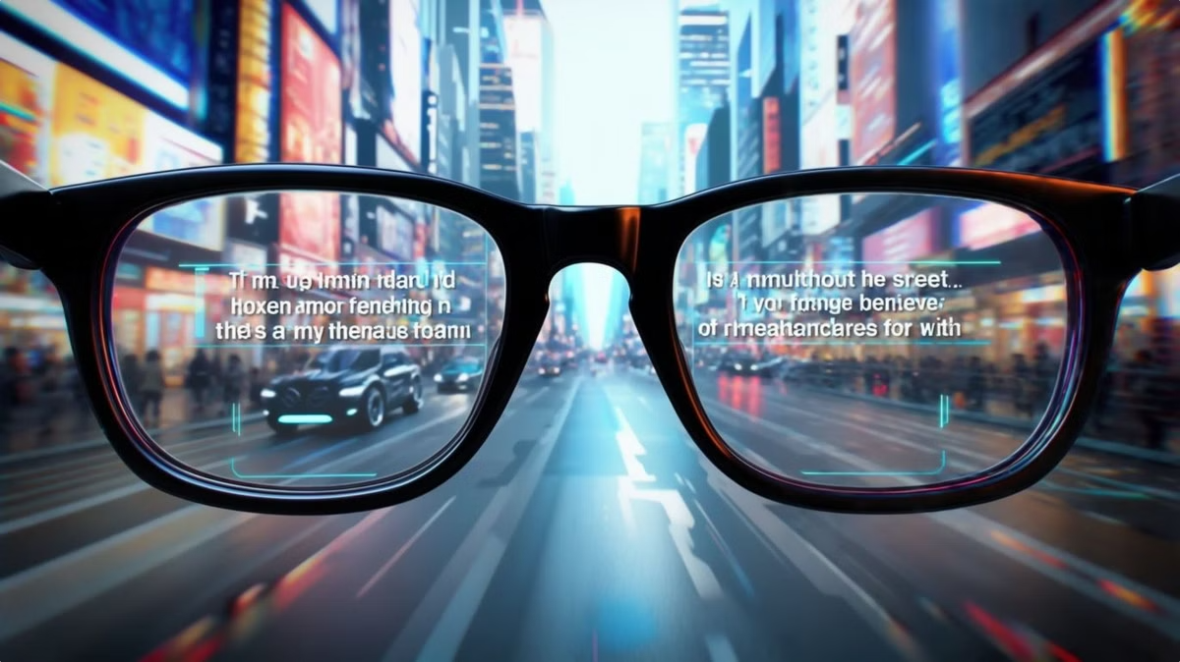
Aankh: Shaping the Future of Accessibility
Aankh is not just a product, it's a movement. Join us in building a future where everyone can fully participate, engage, and experience the world without limitations. Let's empower the deaf and hard-of-hearing community to live life to the fullest.

